Slide 1
Supporting researchers at Kiel University with a German-language implementation of DMPonline
Thilo Paul-Stueve
Kiel University
University Computing Centre
Research Data Management
paul-stueve@rz.uni-kiel.de

Slide 2
Agenda
Public university landscape in Germany
Kiel University
Development of data management services
at Kiel University
German localisation of DMPonline
Outlook

Slide 3
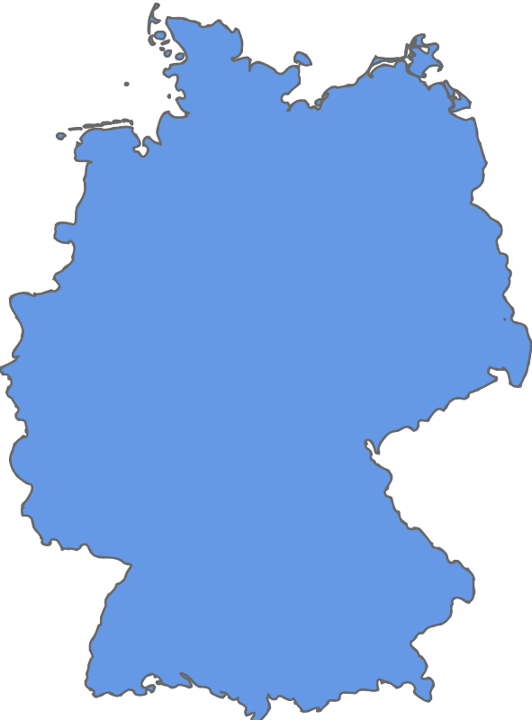

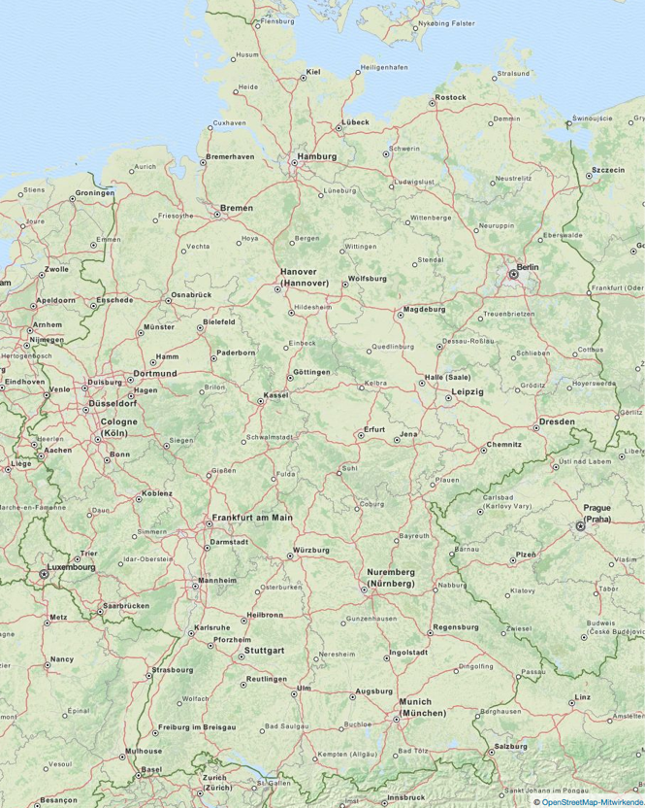
Public University Landscape in Germany
German Higher Education Framework Act
  Framework law
BMBF
  General educational policy
  Research project funding
Notes:
Hochschulrahmengesetzt – German Higher Education Framework Act
BMBF – Bundesministerium für Bildung und Forschung (Federal Ministry of Education and Research)
DFG – Deutsche Forschungsgemeinschaft (German Research Foundation)
Wissenschaftsrat German Council of Science and Humanities provides advice to the German Federal Government and the State (Länder) Governments on the structure and development of higher education and research. Advice is normally always followed.
Allianz der deutschen Wissenschaftsorganisationen – Alliance of Science Organisations in Germany
Hochschulrektorenkonferenz – German Rectors’ Conference

Slide 4
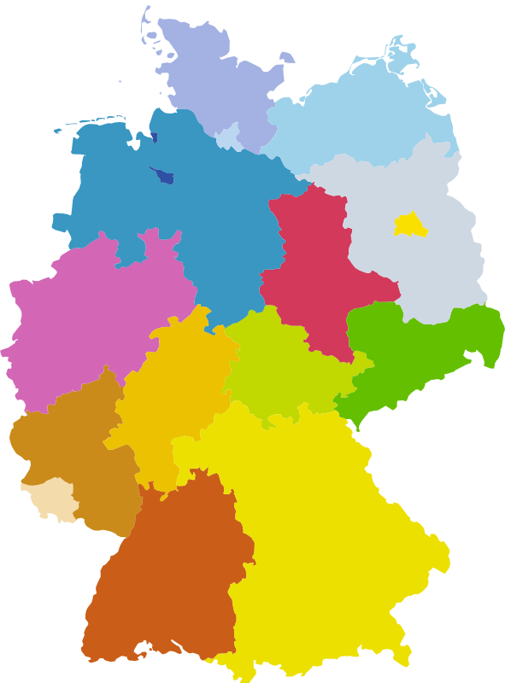
Public University Landscape in Germany
States
  Operate Public Universities
Universities
  Public corporations
Notes:
Professors are civil servants with freedom of research
Again on the country level

Slide 5
Public University Landscape in Germany
Cabinet of Germany
  Digitale Agenda
    Council for Scientific Information Infrastructures
German Research Foundation (DFG)
  Largest research funder
German Council of Science and Humanities
  Advice to the German Federal Government and the State Governments
Alliance of Science Organisations in Germany
German Rectors’ Conference
Notes:
Influences and Organisations
DFG – Deutsche Forschungsgemeinschaft (German Research Foundation)
Wissenschaftsrat German Council of Science and Humanities provides advice to the German Federal Government and the State (Länder) Governments on the structure and development of higher education and research. Advice is normally always followed.
Allianz der deutschen Wissenschaftsorganisationen – Alliance of Science Organisations in Germany
Hochschulrektorenkonferenz – German Rectors’ Conference

Slide 6
Kiel University
Founded in 1665 by Duke Christian Albrecht
8 Faculties:
Agricultural and Nutritional Sciences; Arts & Humanities; Business, Economics and Social Sciences; Engineering; Law; Mathematics and Natural Sciences; Medicine; Theology
Research Foci
  Kiel Marine Science
  Kiel Nano, Surface and Interface Science
  Societal, Environmental and Cultural Change
  Kiel Life Science
Data-driven research
  Discipline-specific data management teams
Notes:
Humanities
Starting Universities Data Management emerged from Kiel Marine Science data management

Slide 7

Development of
Data Management Services
Development of central research data management support
  Project Virtual Research Environment
    Service Office
    Technical infrastructure
    Calculation of costs
    DGF-funded
Cooperation
  Data management teams
    Research foci
    Subject areas
  University’s Central facilities
    University Computing Centre
    University Library
    Central administration
Rights
Metadata
Technology
Curation
Training & consulting
VRE
RDM
introduction
RDM
In subject areas
Publishing /
Citing
Service
Office
Collaboration
& Tools
Application
deployment
Storage

Slide 8
Development of
Data Management Services
Advancement of research areas with not yet established data management
  Consulting innovators and early adopters
Support for research proposals
  Consultation
  Data management plans
Participation in DFG-funded Collaborative Research Centers’ infrastructure projects
  Data management plans
  Data policy development

Slide 9

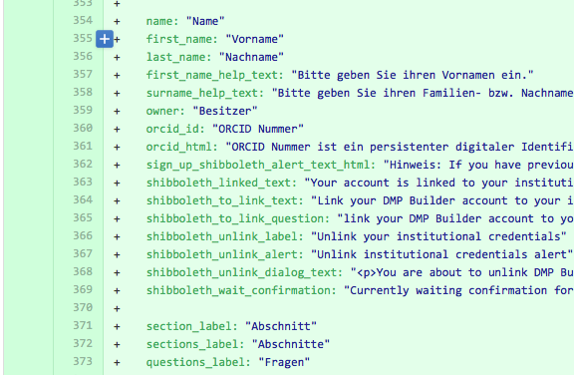


German Localisation of DMPonline
DMPonline Open Source project on GitHub
Cooperation with
  Digital Curation Centre
  Cameron Library of the
  University of Alberta
Research data managers at other German Universities
  Evaluation of test installation
  Feedback on German translation

Slide 10
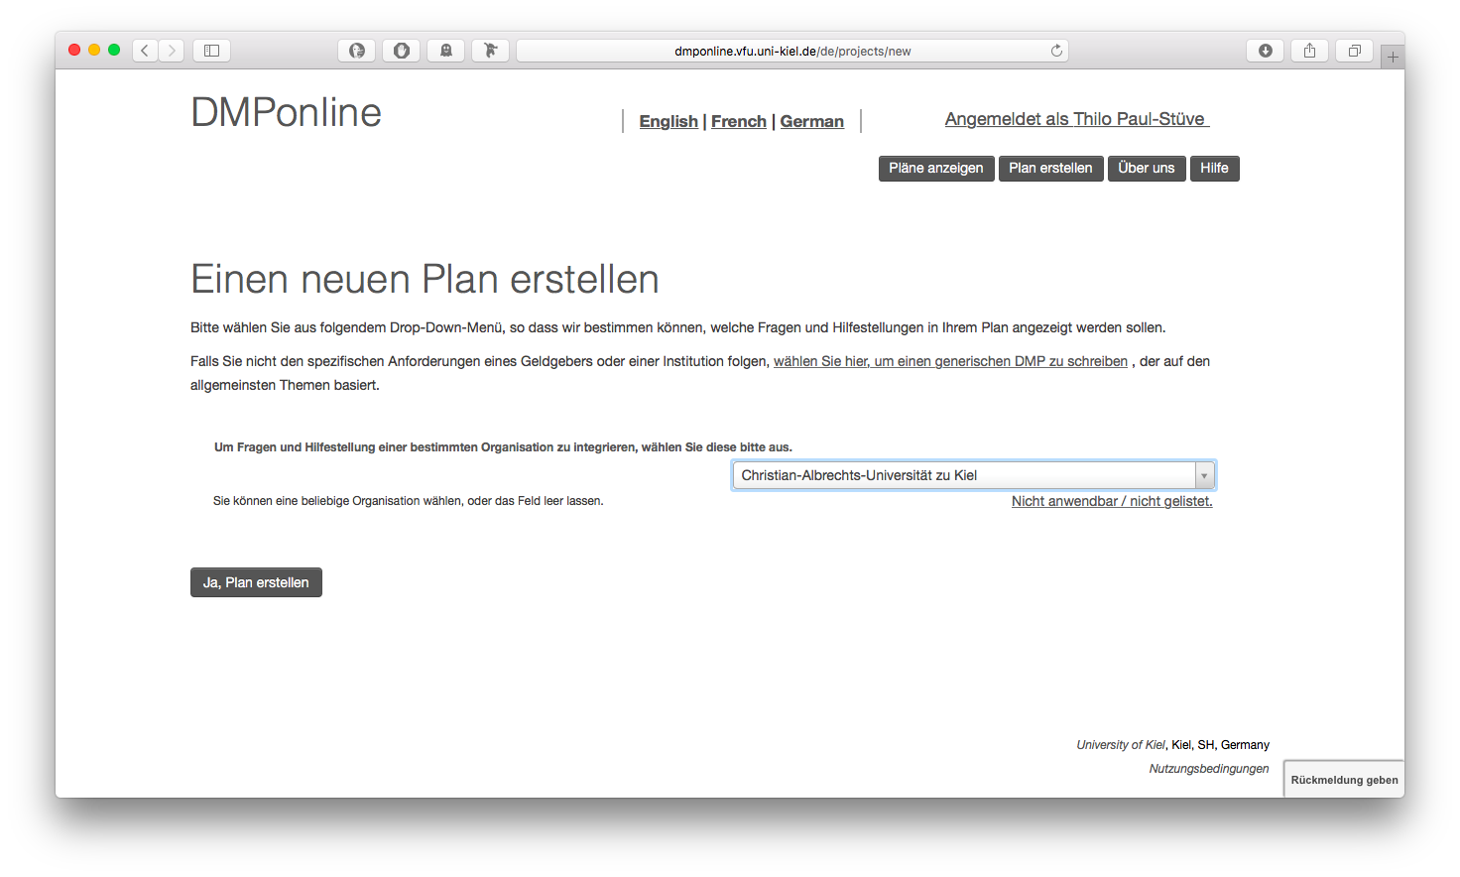
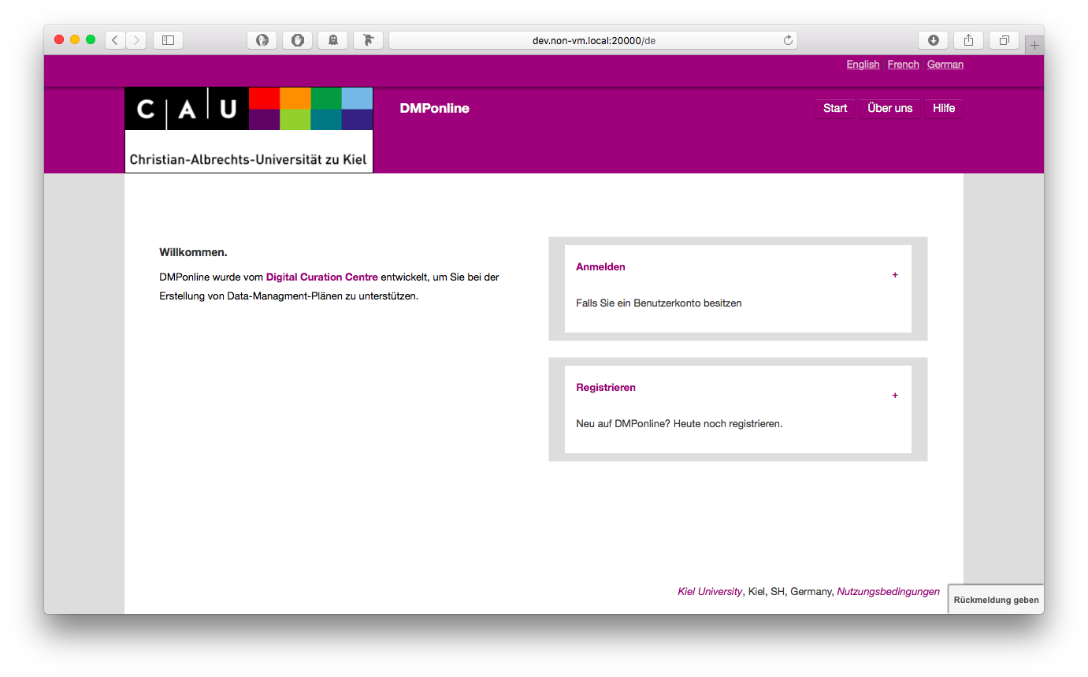
German Localisation of DMPonline

Slide 11
Outlook
DMPonline
  In talks concerning a possible national offer
Data Policy Kit
  Building blocks & plan for creation of data policies
  Departments, projects, joint projects

